Slide 1
CAFÉ DEL CAMPO
SPARKTECH
MIGUEL RODRIGUEZ
VINCEN OBIGWE
SHAO WEN-CHANG
ASADUJAMAN NUR

Slide 2
MOTIVATION
CAFÉ DEL CAMPO
Notes:
Miguel

Slide 3
CAFÉ DEL CAMPO
AGENDA
Description
Technologies
VHDL implementation
FPGA implementation
PCB design

Slide 4
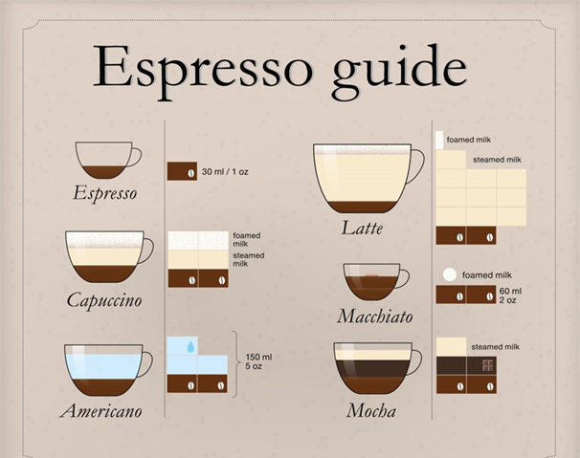
CONCEPT
DESCRIPTION
Notes:
WEN

Slide 5
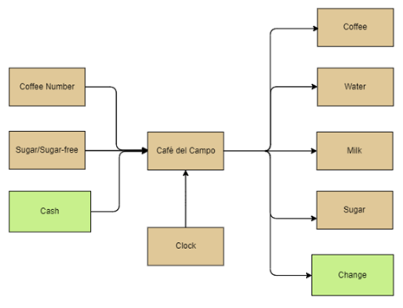
CONCEPT
DESCRIPTION
Notes:
WEN

Slide 6
CAFÉ DEL CAMPO
TECHNOLOGIES
VHDL
FPGA
EAGLE

Slide 7
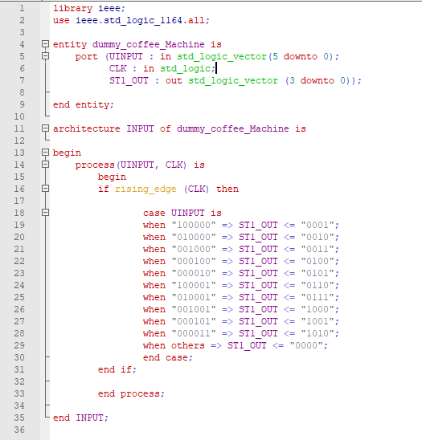
CAFÉ DEL CAMPO
VHDL
Notes:
MIGUEL

Slide 8
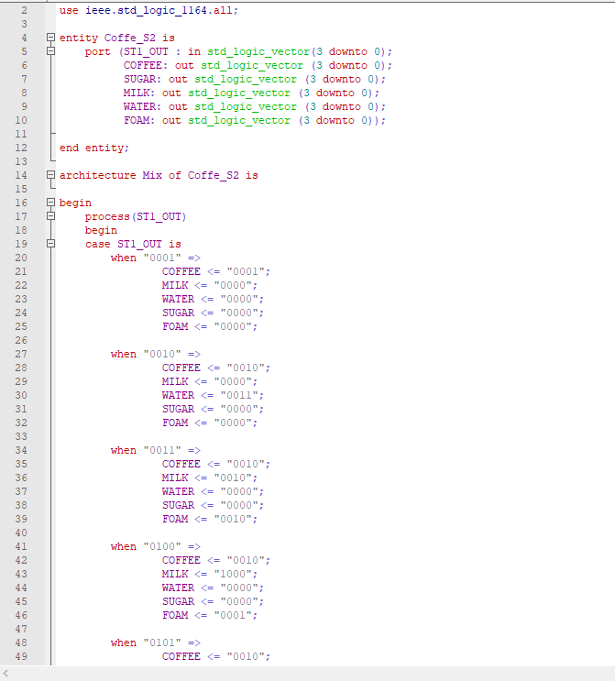
CAFÉ DEL CAMPO
VHDL
Notes:
MIGUEL

Slide 9
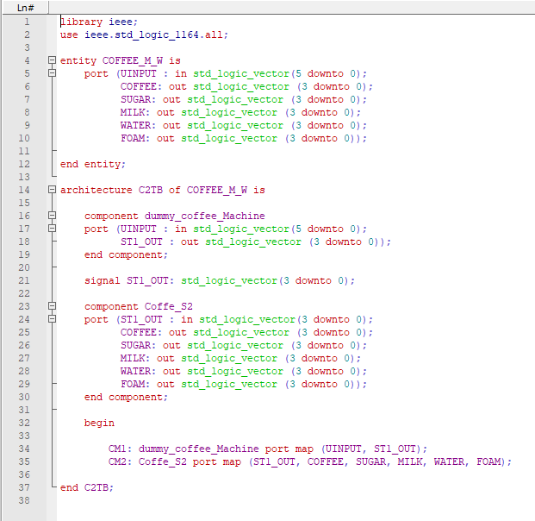
CAFÉ DEL CAMPO
VHDL
Notes:
MIGUEL

Slide 10
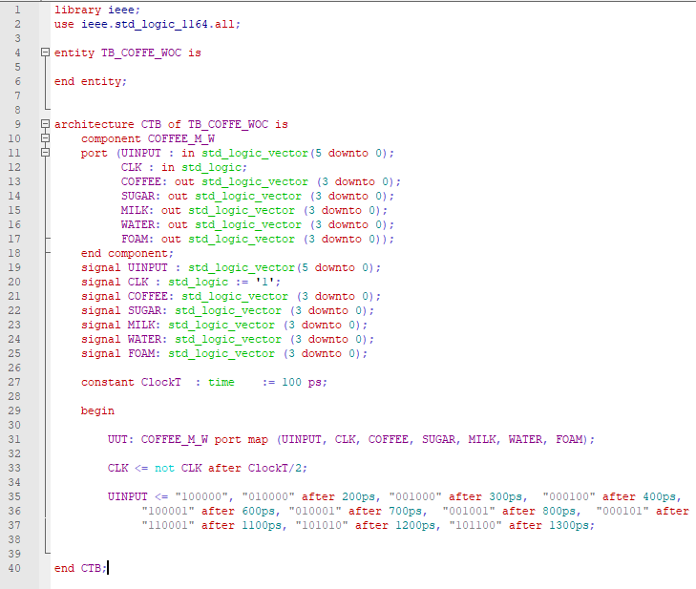
CAFÉ DEL CAMPO
VHDL
Notes:
MIGUEL

Slide 11
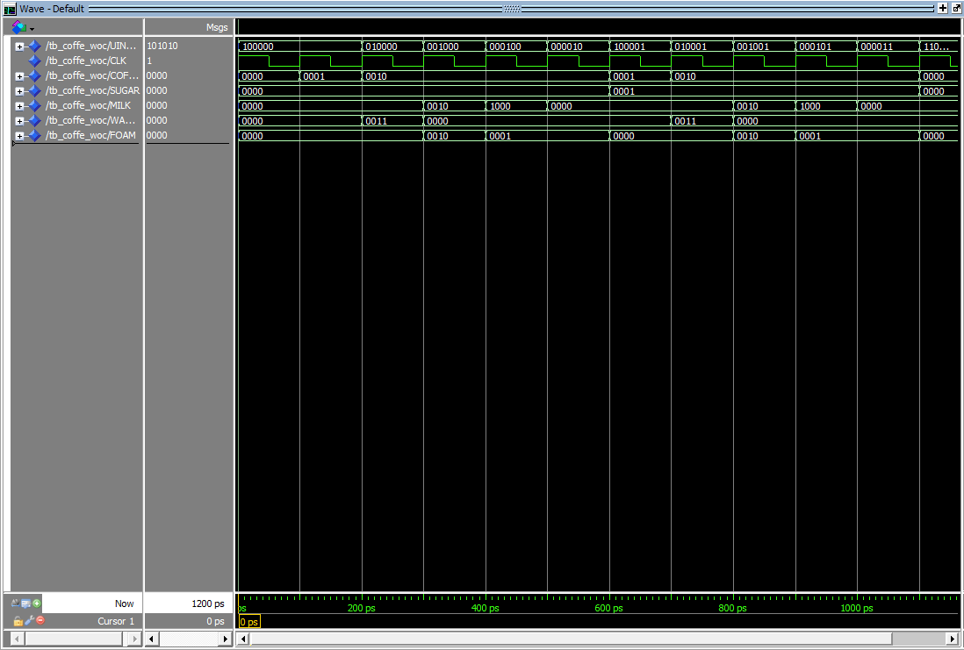
CAFÉ DEL CAMPO
VHDL
Notes:
MIGUEL

Slide 12
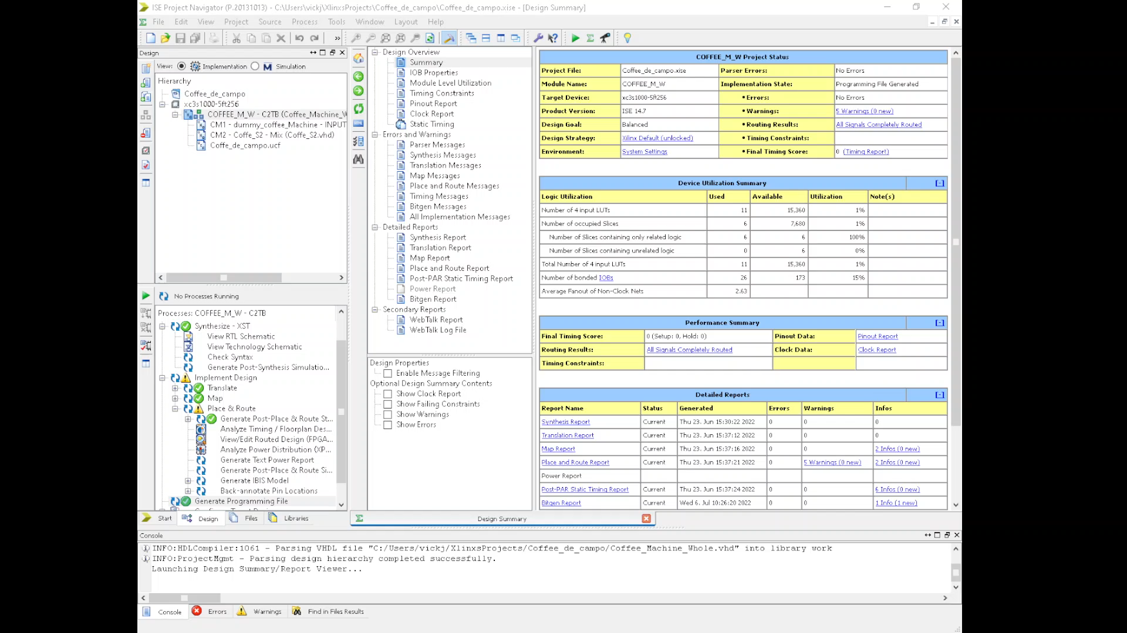
XILINXS
FPGA
Notes:
VINCENT

Slide 13
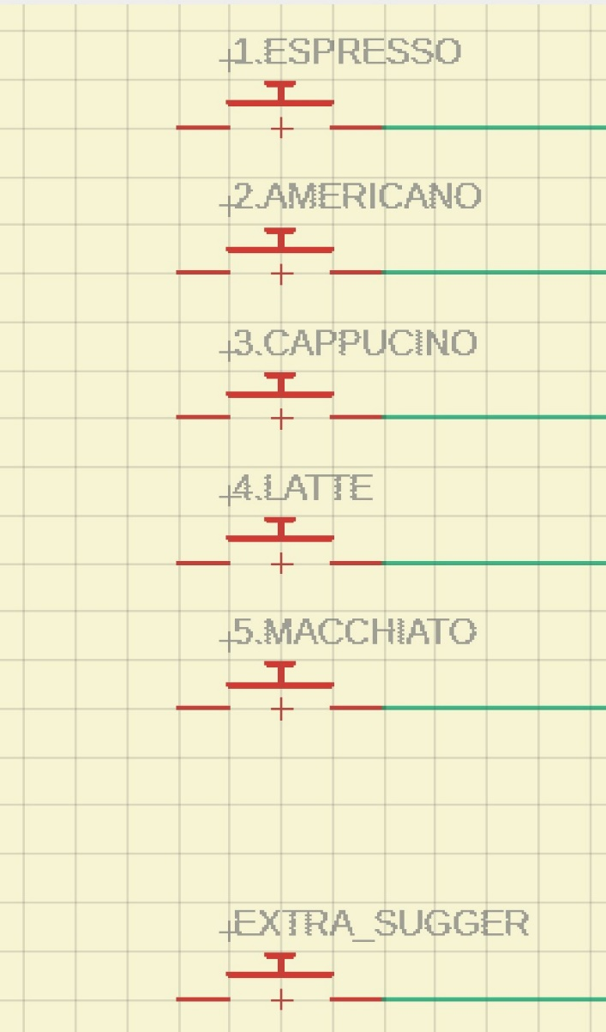
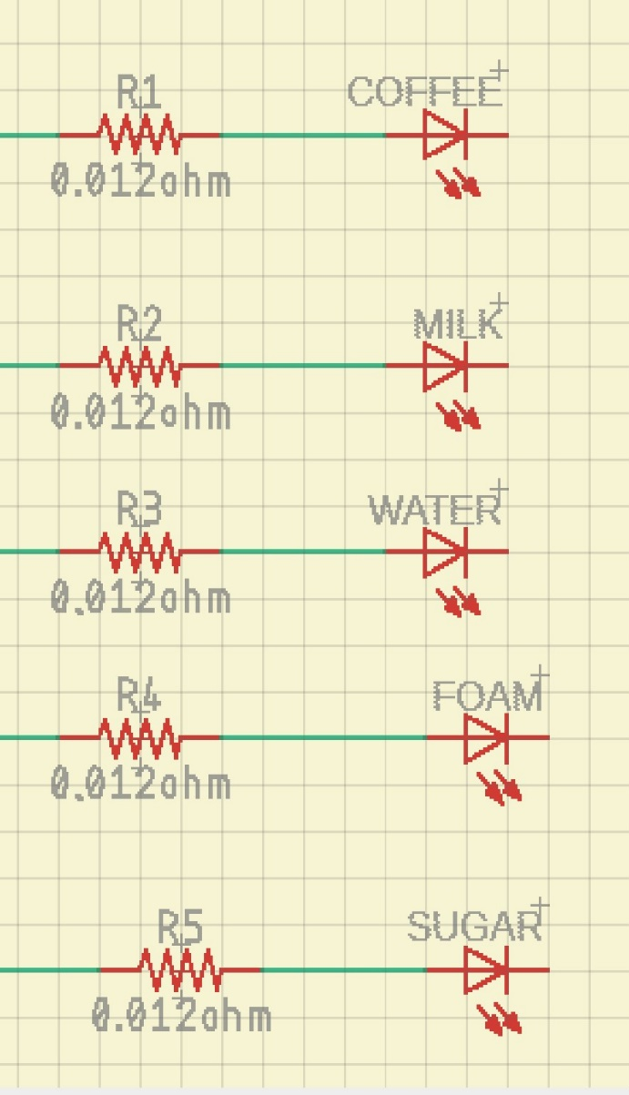
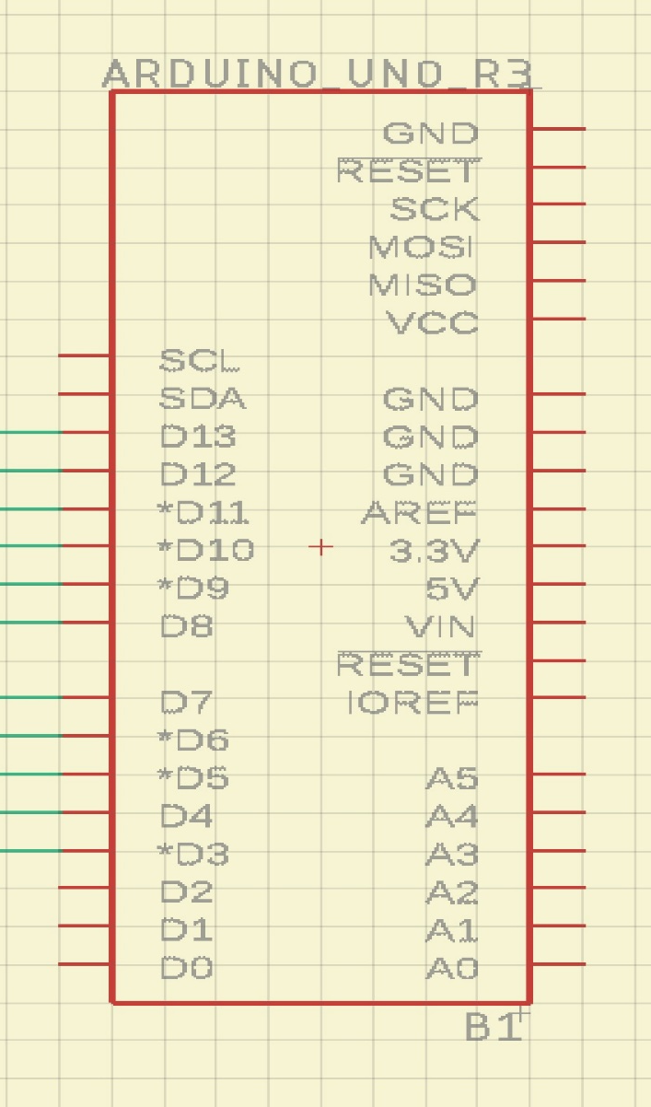
EAGLE
COMPONENTS
SWITCHES
MICROCONTROLLER
EAGLE
Notes:
NUR

Slide 14
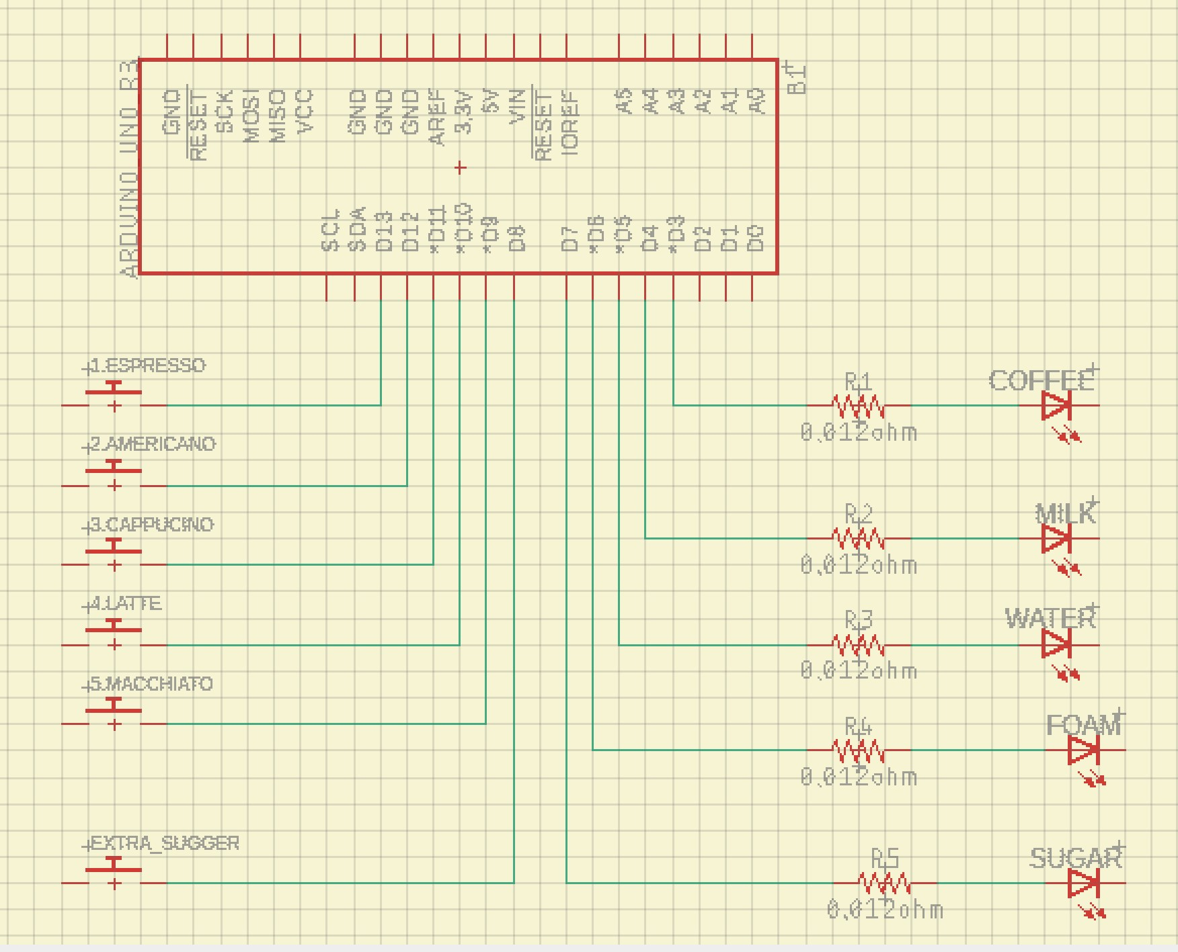
EAGLE
SCEMATIC
Notes:
NUR

Slide 15
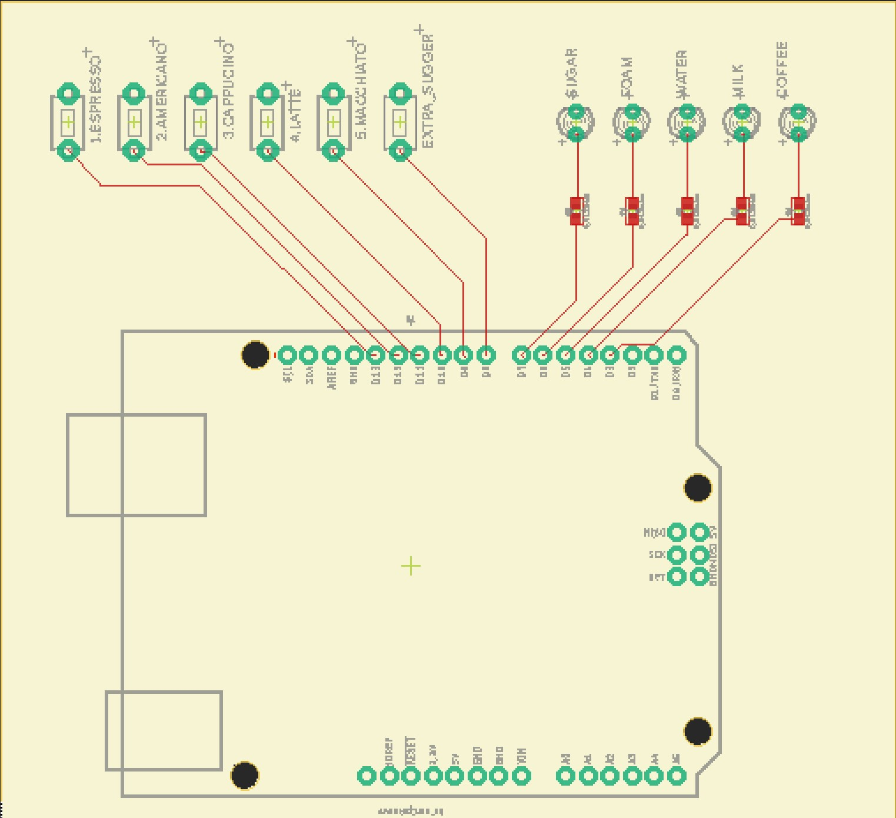
EAGLE
LAYOUT
Notes:
NUR

Slide 16
CAFÉ DEL CAMPO
CONCLUSION
Developing Café del campo has been an interesting journey from the Ideation to FPGA programming.
We strived to develop a product that affects the life of missions of people and makes delivery of coffee easy and seamless.

